Slide 1
Door Lock System
By :-
Kanishka :CS21MDS14034
Shravya :CS19MDS11017

Slide 2
Use Case
The objective : To create a Door Lock system based on the IOT and Face recognition system, that recognises the owners of the house and unlocks the door for them
Description: The proposed door lock system is based on the pi camera sensor, that first detects the presence of face in the frame and then runs a face recognition algorithm using raspberry pi to match the face with the ones that are the owners of the house. In case of a match it unlocks the door and logs the entry in a database, in case of mismatch it send a notification to host for approval and owner has to approve the entry

Slide 3

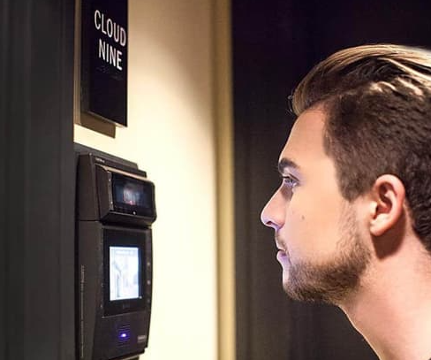
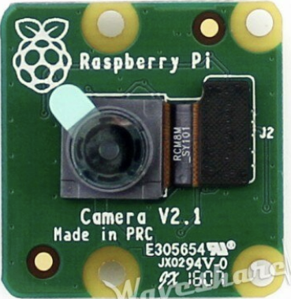
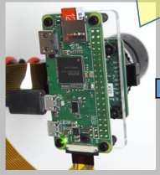
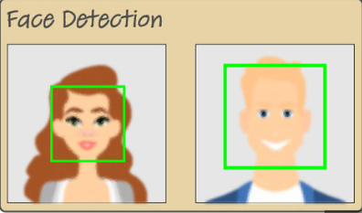
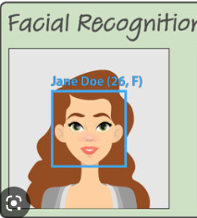



End to End : Design
Yes
Is there a match ?
No
RPI
Retrain
Notify
Approval
Update Authorization List

Slide 4

Flow Chart
If user input =approved/deny /remember?
Send the message to aws to trigger SES (notification
(publisher:RPI, Subs:AWS)
Remember
No
Live Camera
denied
Approved
Yes
Trigger AWS lambda function
Face Verification
Open the Door
Trigger AWS lambda function 2
Image Capture/Camera
Send the message to AWS Subs:AWS
Publish msg to rpi (unlock)
Subs;rpi, pub:AWS
Face Recognition
Dynamo DB- AWS
Database
Publish msg to rpi (remember)
and append the encodings generated for the face to AWS S3
Subs;rpi, pub:AWS
Feature Extraction/encoding generation
AWS:s3 Bucket (contains face encodings of authorized users)

Slide 5
Hardware Requirements
Software Requirements
Raspberry Pi Kit
Raspberry Pi 3Bplus
Raspberry Pi Camera V2 Module
MicroSDCard –16GB Class10
Raspberry Pi Power Supply (5V 2.5A)
LED
Resistor(220 or 330 ohms should work)
Breadboard
Jumper wires
Servo motor
Latch
Display
Python
AWS MQTT
AWS
Lambda
SES
Azure
Django/Flask
Pushover/Twilio

Slide 6
Modules to be developed
Module 1: Face detection module
Module 2 : Face recognition module
Module 3: Notification and app creation
Module 4: Database entry
Module 5 : MQTT Publisher/Subscriber Code
Contributions:
Kanishka : Module 1 & 2
Shravya : Module 3,4 & 5,HW

Slide 7
Deliverables
DEMO: Final demonstration of entire development using a prototype.
CODE: GitHub repo with code and samples of
Face detection
Face recognition
MQTT
Database entries
AWS function:Lambda

Slide 8
Updates
Dlib and face recognition libraries will be used for face detection and recognition
https://pyimagesearch.com/2018/09/24/opencv-face-recognition/
If there is a new authorized user, the user details are stored in S3 and the model will be retrained with the new user details.
AWS will be used for training as it has high computing power compared to raspberrypi
Computations will be performed on AWS or Raspberrypi based on the response time.

Slide 9
References
https://www.youtube.com/watch?v=o-x1PE0LVKM
https://www.pantechsolutions.net/capturing-an-image-using-mobile-by-ip-camera-with-raspberry-pi#:~:text=As%20the%20Raspberry%20Pi%20beginner,when%20compared%20to%20USB%20camera.
https://ijcrt.org/papers/IJCRT2106293.pdf
https://www.youtube.com/watch?v=-icJaVEPBaM

